Slide 1
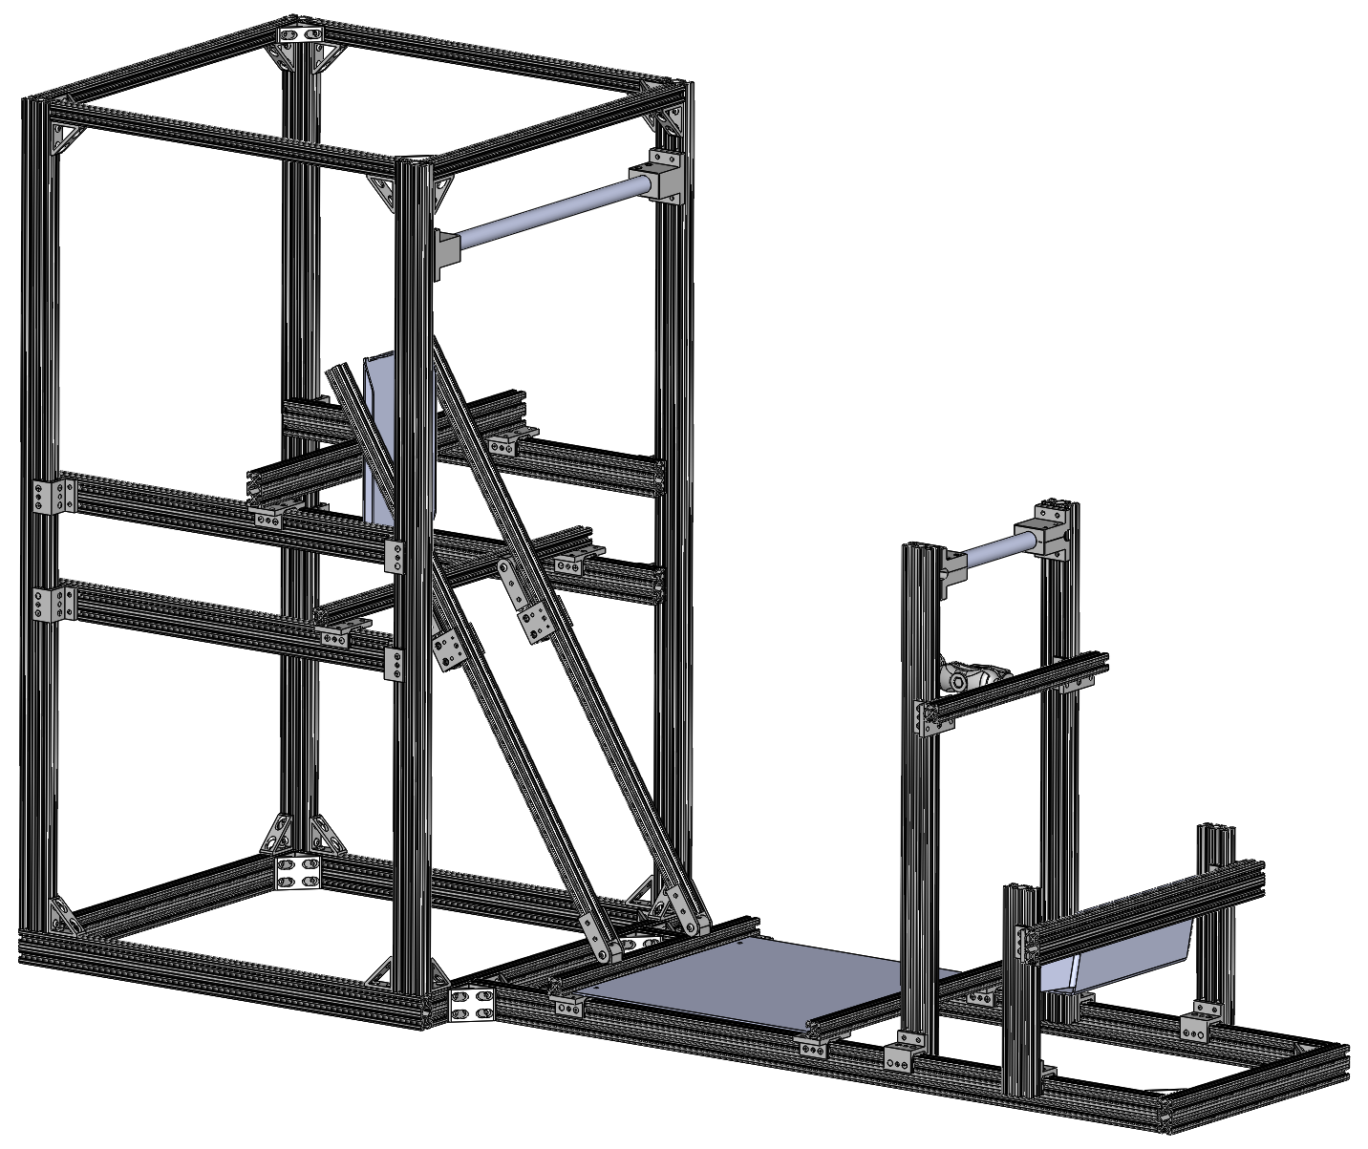
Driver Ergo Rig PDR
System Lead: Jennifer Yang
Manager: Victoria Han

Slide 2
DESIGN GOALS
Create an adjustable rig
Receive feedback from drivers on how to comfortably position elements the driver interacts with
Reusable for many years
Notes:
We want to be able to find the most comfortable position for the drivers
In order to do this, we have the following goals in mind:
Adjustable rig
Driver feedback on comfort
Reusable

Slide 3
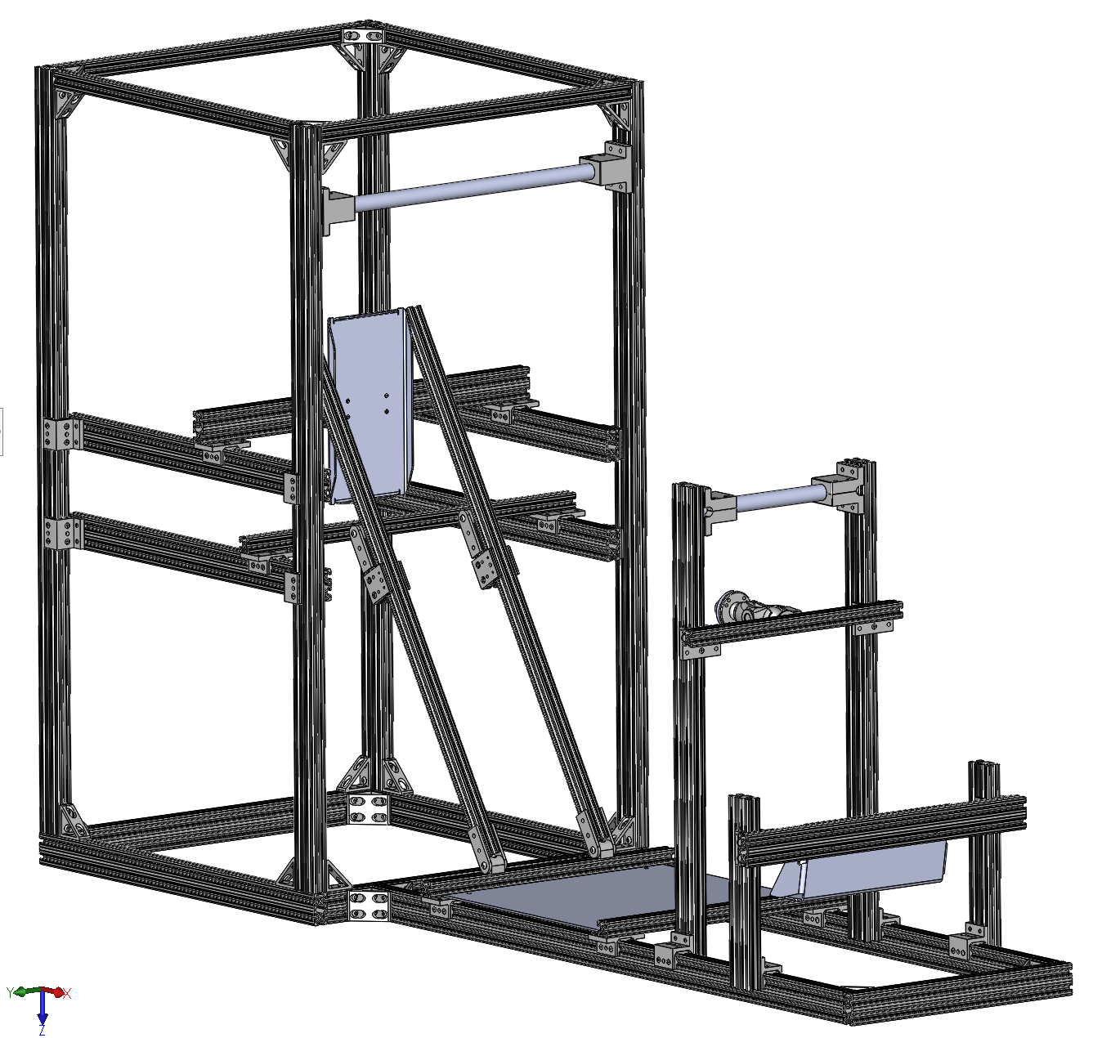
DESIGN SPECIFICATIONS
Steering wheel
Z position
X position
Angle about Y
Pedals
Z position
X position
Headrest
Z position
X position
Shoulder bar
Z position
X position
Seat back
Angle
Front roll hoop
X position
Z position
Main roll hoop
Z position
Notes:
Choose to adjust these elements based on goals
Most valuable for positioning
Origin at base of MRH
XYZ see little axis thing

Slide 4
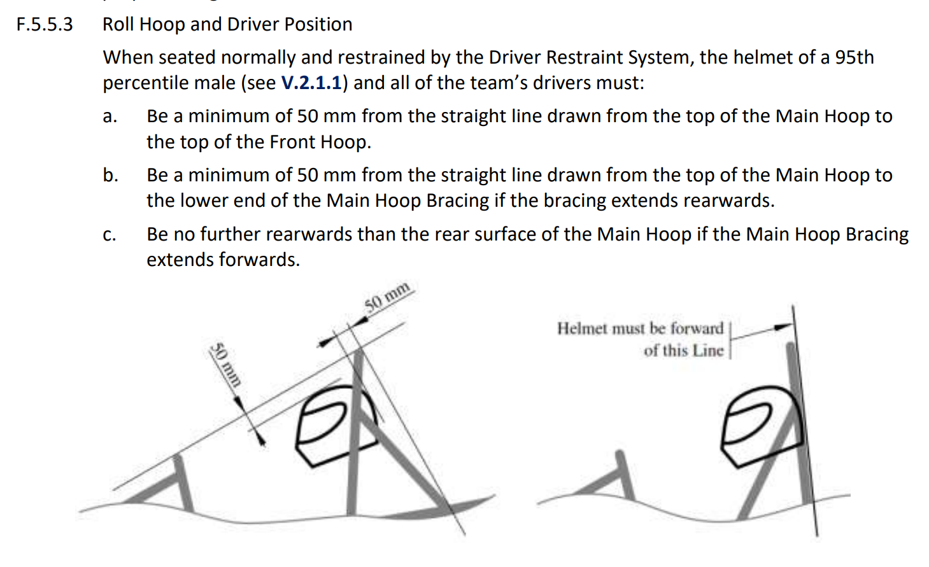
DESIGN CONSTRAINTS: RULES REQUIREMENTS
Link to rules spreadsheet here
Important Rule: F.5.5.3 – Roll Hoop and Driver Position
When seated normally and restrained by the Driver Restraint System, the helmet of a 95th percentile male (see V.2.1.1) and all of the team’s drivers must:
Be a minimum of 50 mm from the straight line drawn from the top of the Main Hoop to the top of the Front Hoop.
Be a minimum of 50 mm from the straight line drawn from the top of the Main Hoop to the lower end of the Main Hoop Bracing if the bracing extends rearwards.
Be no further rearwards than the rear surface of the Main Hoop if the Main Hoop Bracing extends forwards.
Notes:
Linked a spreadsheet of rules that constrain the movement allowance
Key rule is the F553
They do this at comp so we want to make sure it works before chassis design
Essentially is used to ensure that the driver is within the car and will be safe in the event of a rollover
Test is roughly performed by having a long straight object placed from FRH to MRH and checking to see that helmet to stick is at least 50 mm

Slide 5
DESIGN CONCEPT - Overall Structure
Simulates the spacing of an actual car
Components adjustable with linear slides and pivots
Components held in place with brakes
Notes:
Simulates structure and spacing of real car while simplifying it so that we can move things
Mostly built out of 8020 pieces so the adjustable components move on linear slides and pivots
The off the shelf slides can come with brakes which we can use to keep components in place
We can measure and mark distances from the aforementioned zero DO THE ZERO

Slide 6
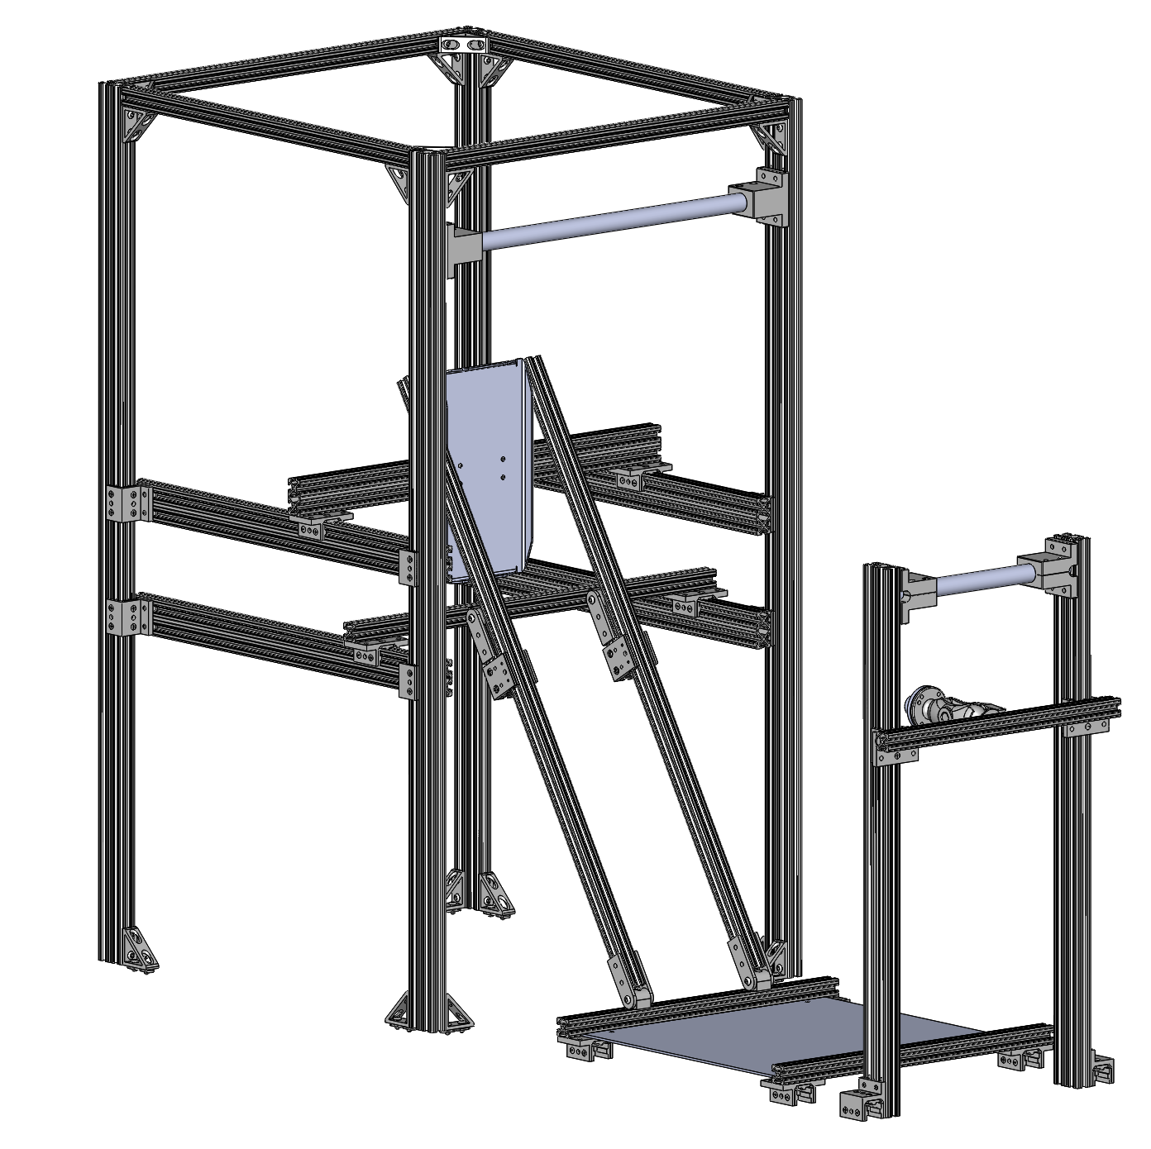
DESIGN CONCEPT - Front and Main Roll Hoops
FRH can change position in X
FRH and MRH can change position in Z
Can test if the configuration meets the requirements of rule F.5.5.3.
Notes:
Goes back to rule F553
In order to figure out where the top of the MRH and FRH need to be, included two tubes — one across each
We can then use a yardstick or some flat object to perform the test and see that we meet the requirements in the assorted configurations
Both of these slide in the Z direction
MRH is regarded as zero so that remains in place but the FRH piece can move forward and back in the X position for different configurations

Slide 7
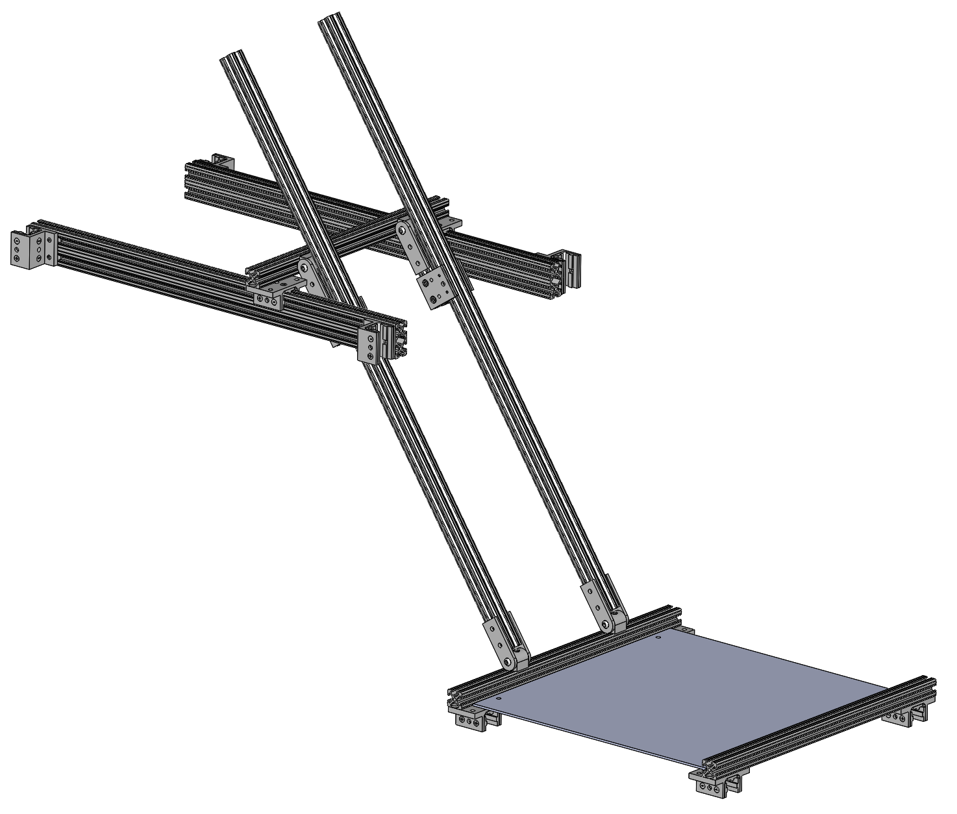
DESIGN CONCEPT - Shoulder Bar and Seat Back
Seat back angle adjusts based on
X and Z position of the shoulder bar
X position of the seat
Seat cushion can be attached to simulate a real seat
Allows driver to test different seat angles based on the shoulder bar and seat positions
Notes:
The seat back is the key point here
Want to:
Test X and Z positions
Maximize comfort when using
Designed such that:
Slides along rails for X position
Slides along vertical rails for Z position
Attaches to MRH structure
Shoulder bar defines one point of angle, seat bottom defines other point

Slide 8
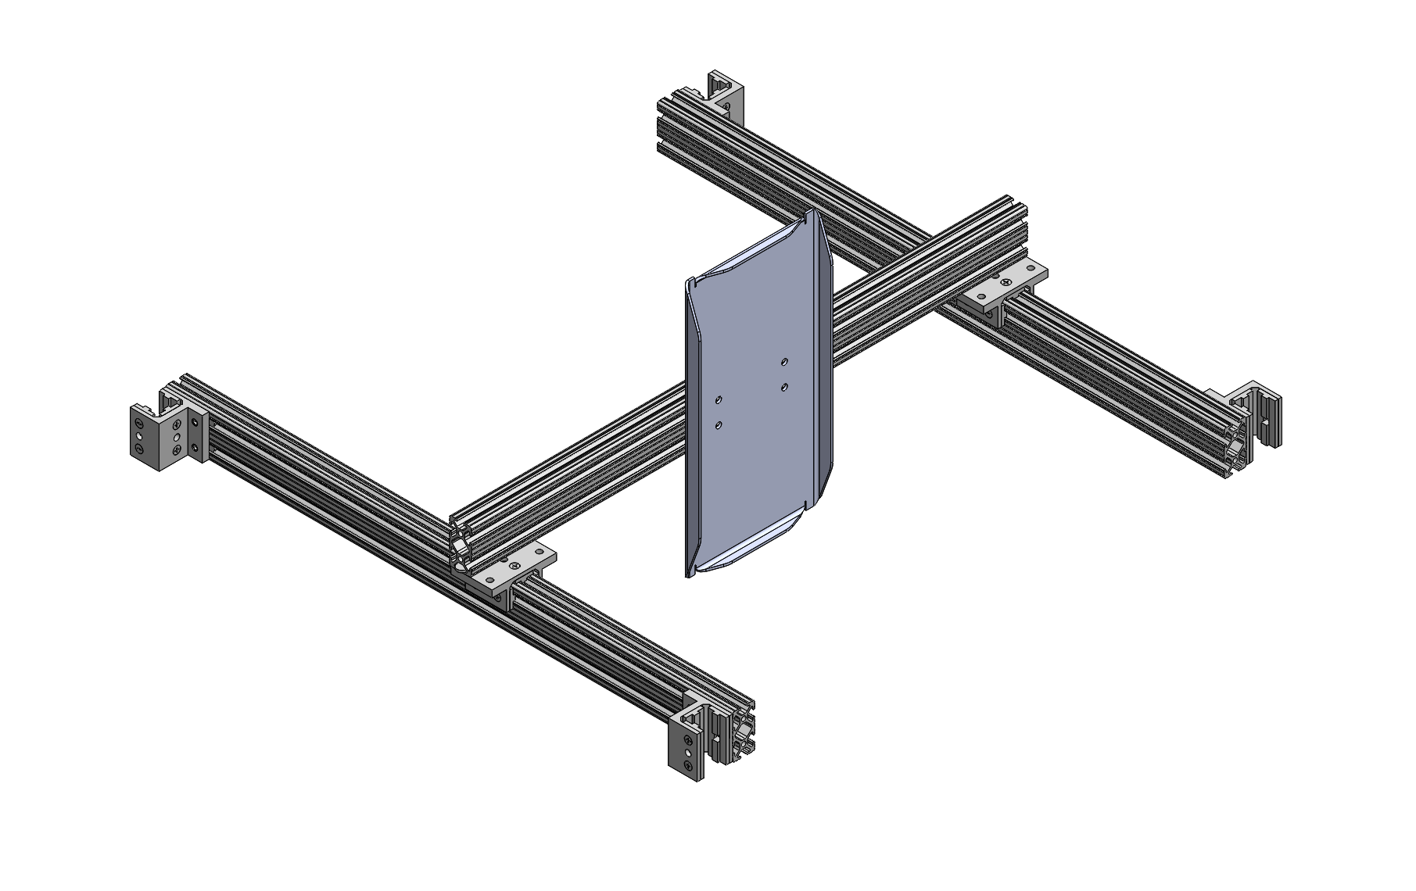
DESIGN CONCEPT - Headrest
Can adjust X and Z position
Headrest support can be attached to metal backing to simulate an actual headrest
Allows driver to test various headrest locations
Manufacturing: Waterjet cut and bent
Notes:
Want to:
Test X and Z positions
Maximize comfort when using
Designed such that:
Slides along rails for X position
Slides along vertical rails for Z position
Attaches to MRH structure
Assumed vertical position of headrest
Dimensions based on 20E design
Can attach headrest support piece to metal backing shown here
Manufacturing: waterjet cut and bent - TENTATIVE

Slide 9
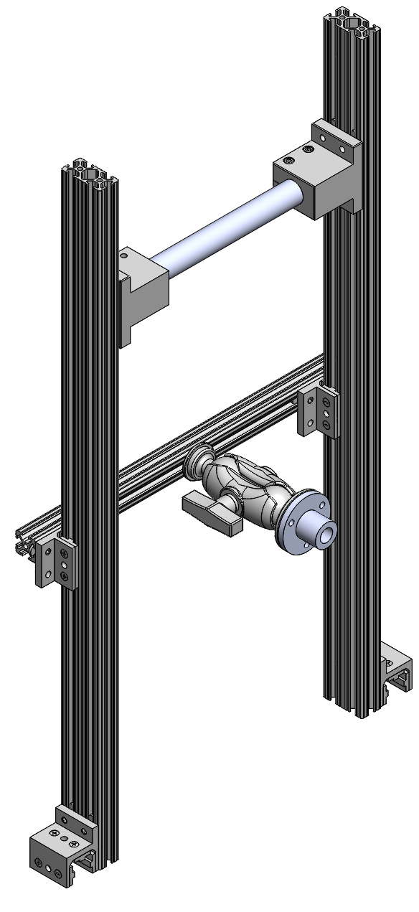
DESIGN CONCEPT - Steering Wheel
Can adjust X and Z positions and the angle about the Y axis
Original design uses ball joint to increase range
Can attach current steering wheel or any steering wheel that uses the QR1 Standard Steering Wheel Quick Release System
Allows driver to test their ideal configurations while sitting in the seat
Notes:
This is the original design of the steering wheel
We wanted to:
move it in the XZ directions and angle about the Y
Attach a real steering wheel
Decided to use same quick release system as we use on the car so we can put current or previous steering wheels with this system on for better testing
Test comfort by combining this with various seat positions
Did this by:
Attach steering wheel to FRH section
Slides on main rails for X position
Slides along FRH vertical pieces for Z position
Uses ball joint to change X, Z, and angles relative to FRH
Original design uses ball joint for range and angles
Issue:
doesn’t fully allow us to test steering wheel positions independent of the FRH, which this is attached to - specifically positions in X and angle about Y have limitations
New design pictures on next slide

Slide 10
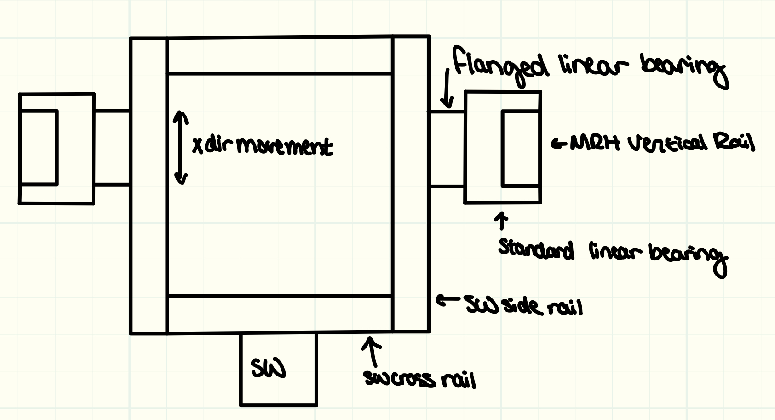
DESIGN CONCEPT - Steering Wheel
Top view of new concept sketch
Notes:
New design sketch - No CAD yet bc it’s wip and planned as post PDR
This design is roughly the X and Z movement
Y angle and steering wheel spinning go in the SW box area but sketch still WIP - have idea for them currently

Slide 11
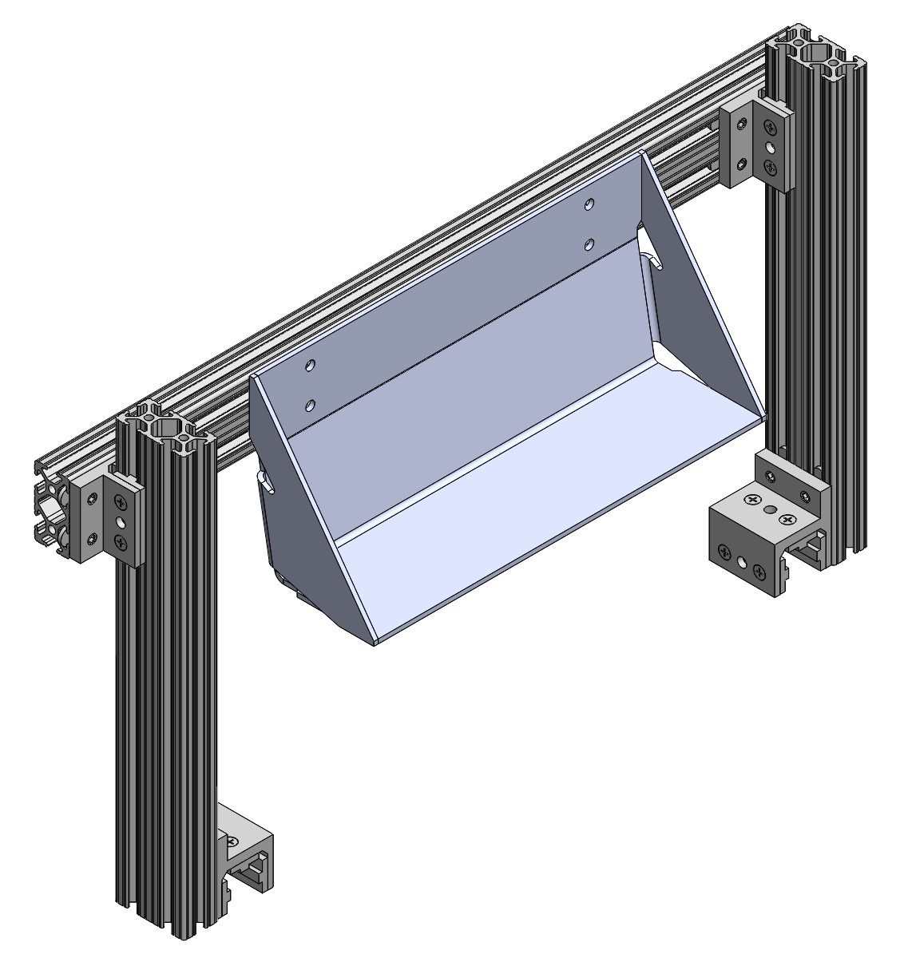
DESIGN CONCEPT - Pedals
Can adjust X and Z positions
Heel support modelled off current design (angle and width)
Allows driver to test different distances in X and Z for pedal placement
Manufacturing: Waterjet cut, bent, and welded
Notes:
Want to:
Test X and Z positions
Maximize comfort when using
Designed such that:
Slides along rails for X position
Slides along vertical rails for Z position
Heel support is modeled off the 20E design for heel cup in terms of angle and overall width
Manufacturing notes:
Waterjet cut + welded - TENTATIVE
Discussion for later:
Test how much force we can put on the pedals in various positions

Slide 12
COST ESTIMATE
Link to BOM spreadsheet here
Current cost estimate: $2,619.50
Additional Costs:
Tube Stock
Sheet Metal Parts
Notes:
This is an expensive thing wow
Current cost estimate is over 2600
Certain costs are not yet calculated because:
There is some common stock that we likely have, such as round tube stock
Sheet metal parts might be exported out in an order but that comes later
Why expensive? Bc we gotta spend CMU money so that we can keep getting it

Slide 13
NOTES AND CONCERNS
Student(s) needed to take over the project in the spring semester
Possible additional feature:
Side Impact Member
Z position
Y position
Angle about Z
Torque measurement for steering wheel
Force measurement for pedals
Notes:
No current timeline for a few reasons!
Need student(s) to take over for in person building!
BUT we have no clue when we can actually build things because access
However this is v modular so it could be split into sections
EX: pedals, steering wheel/FRH, base — seat/shoulder bar and headrest can be independent but will have to work with overall MRH structure
Few things we wanted to consider to make this more usable — basically discussion time yay:
Side impact member:
Might be nice to have
Meant for keeping elbows in car
Do we want to do something formal for it?
Aiden gave great suggestions! Thoughts and suggestions for how we might want to do this? Would like to keep it mechanical to avoid extra complexity of electromechanical
Torque measurement for steering wheel
Force measurement for pedals
TAKE NOTES HERE

Slide 14
Notes:
Thanks

Slide 15
CONTENTS
Design Goals
Design Specifications
Design Constraints
Design Criteria: Rules requirements
Design Concept
Cost Estimate
Notes and Concerns

Slide 16
DESIGN CRITERIA: CONSTRAINTS/CONSIDERATIONS
These next few slides in your PDR should describe the various constraints/factors that were considered when designing your system. In the following slides you will see a list of potential constraints to consider. Not all categories listed will be relevant to your system. Each system is different; choose relevant details to bring up as necessary. Your goal is to tell a cohesive design story.

Slide 17
DESIGN CRITERIA: CONSTRAINTS/CONSIDERATIONS
Physical Loading:
What loads are being applied to your part?
Consult with VD/Analysis group if you need help deriving loads
Examine out-of-plane/non-ideal loading conditions?
How many g’s will your part need to withstand?
Is fatigue a factor? Does your part get loaded cyclically?
Thermal Loading:
How much heat will you need to reject?
Will your part reach temperatures where material properties change?
Notes:
Seat bottom is really just put weight on plywood type thing
Steering, pedals
Not designed in yet

Slide 18
DESIGN CRITERIA: CONSTRAINTS/CONSIDERATIONS
Power Consumption:
How much power does your system require?
Are you limited in power consumption?
Material Constraints:
Are you limited to a certain material?
Sourcing Constraints:
Are we limited to only sourcing from a specific vendor or manufacturer?
Are there other alternatives?

Slide 19
DESIGN CRITERIA: CONSTRAINTS/CONSIDERATIONS
Design for Manufacture/Assembly
What machines are you limited to when manufacturing your part?
What kind of timeline will you need to hit for manufacturing, what could cause that to slow down?
How serviceable do you want your system to be? How serviceable does it need to be?
Input from past system leads
What are certain aspects that past system leads found good/bad?

Slide 20
MANUFACTURING
Brief points on how you plan to make everything. Mention if you will need help from a welder or other team member, or if you will use an outside company.
Ex: Send _____ part to NREC for waterjet
Ex: Make _____ part with Dave on CNC mill
Make sure to address anything with a long lead time!

Slide 21
DESIGN CONCEPT TWO
If relevant, have multiple slides with other design ideas.
If you have two different ideas for your system, review them with VP or Project Manager first before spending time on both.

Slide 22
ASSEMBLY
Brief points on how you would assemble the system
Brief order of operations

